Slide 1



Metadata Improvement: the BCO-DMO Use Case
Cynthia Chandler, Adam Shepherd, Danie Kinkade and Shannon Rauch Biological and Chemical Oceanography Data Management Office Woods Hole Oceanographic Institution
12 January 2017 2017 Winter ESIP, Bethesda, MD
Notes:
Presented by Cyndy Chandler (BCO-DMO, WHOI, Woods Hole, MA, USA)
12 January 2017 at 2017 Winter ESIP
C Chandler, A Shepherd, D Kinkade, S Rauch (2016) "Metadata Improvement: BCO-DMO Use Case" Presented in session: Wiki Documentation. 2017 Winter ESIP. Bethesda, MD 12 January 2017.

Slide 2
U.s. nsf-funded research data
funded by US NSF to provide data management support at no cost to researchers funded by the program managers who fund BCO-DMO
data from hypothesis-driven research projects
single PI to large coordinated research programs

Slide 3
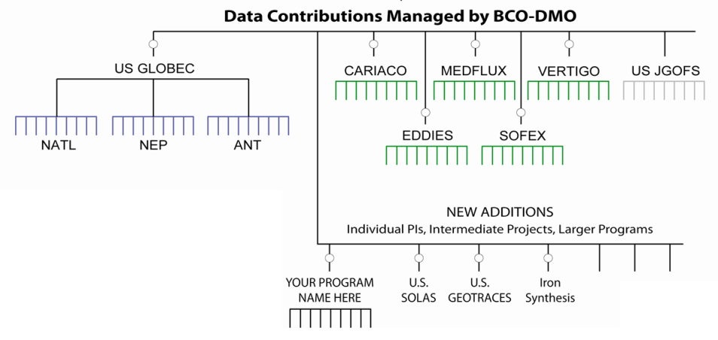
In the beginning . . .
Fall 2006: data from 13 research programs

Slide 4
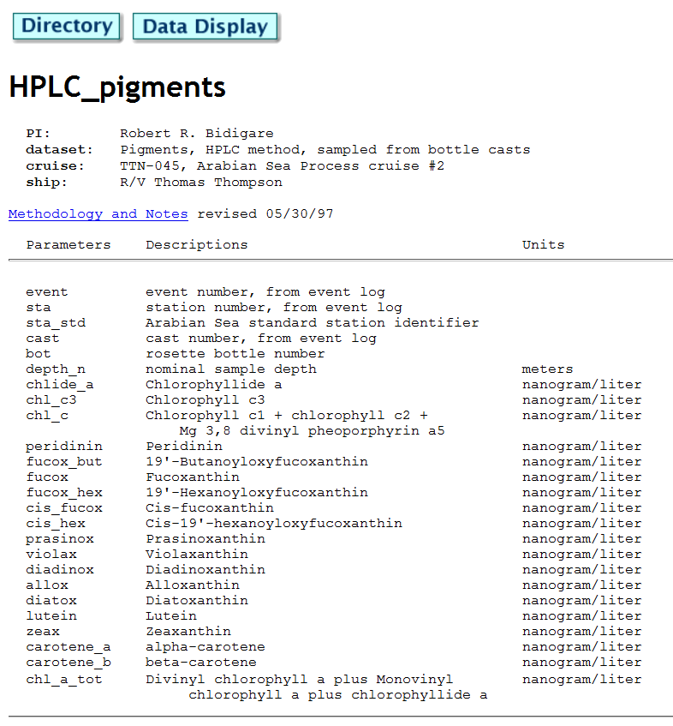

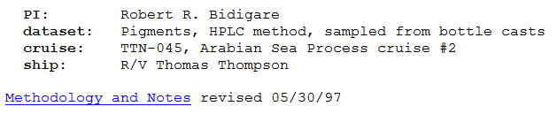
Metadata ~ legacy data systems
Human readable text metadata records from legacy systems managed by BCO-DMO
U.S. JGOFS
Notes:
In 1990s we recorded metadata in human-readable, text files linked to additional information using the nascent World Wide Web (http)

Slide 5
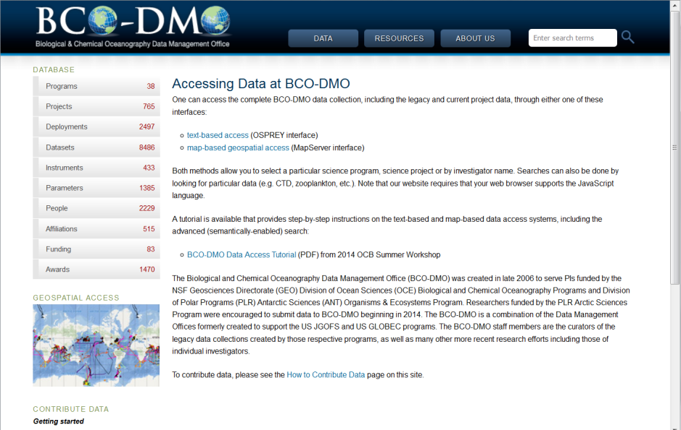
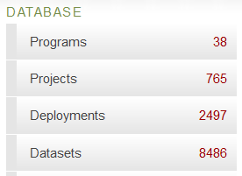
Drupal: single catalog
Notes:
Web interface – human readable HTML pages with metadata collected over several decades for different projects

Slide 6
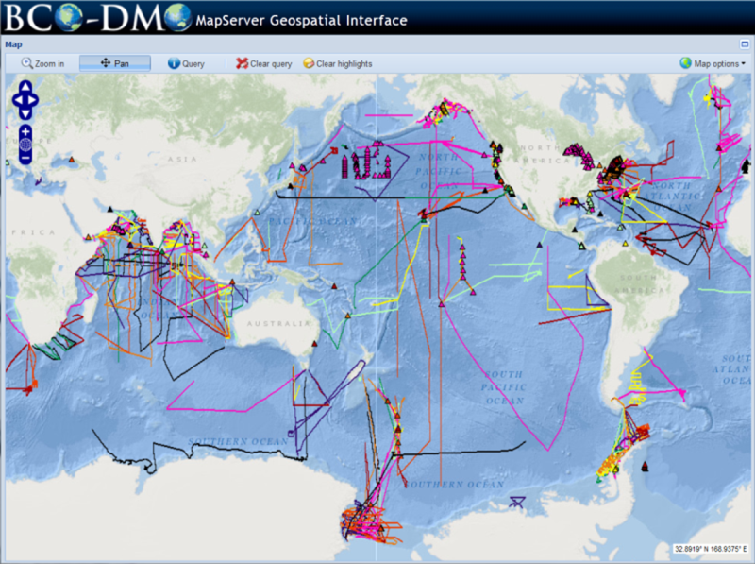
BCO-DMO ocean research DATA
Notes:
Data access via map interface – good for human access to geospatial data

Slide 7
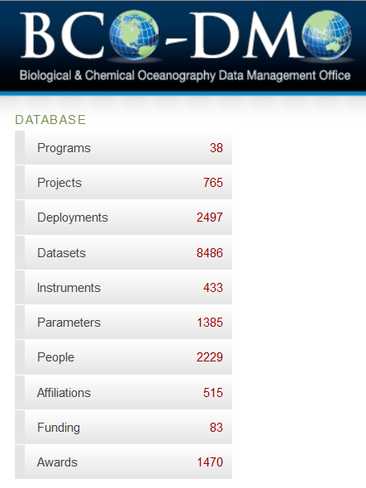
BCO-DMO catalog
Each of the 8486 data sets is described by metadata in the BCO-DMO catalog.
Data access systems driven by those metadata records.

Slide 8


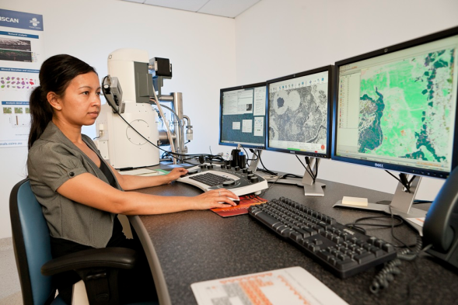
challenge
Enabling machine access.
Notes:
Left: (alimayarvideo.com, 2015)
Right: (blog.udemy.com/types-of-computer-networking/, 2014)
Final: (Damien Smith Photography, 2012, //csiro.au/, QEMSCAN)

Slide 9

challenge
Improved metadata is one way to work toward . . .

Slide 10
challenge
Scenario: someone wants to harvest a subset of our datasets based on some criteria. We prefer to handle these requests with the appropriate SPARQL query (Linked Data).
BUT … the request may be from someone who isn’t prepared to consume Linked Data

Slide 11
Option B: other standards
Q: What metadata standard do you use?
BCO-DMO: metadata are in a MySQL database and can be published out in a variety of ways. What metadata standard would you like?
A: … usually something we haven’t published before, but we could, but how much effort would that be?
Notes:
If Linked Data isn’t convenient, what other standard would work better for you?

Slide 12
Metadata publication
ISO 19115-2
OAI-PMH (ISO-19115), W3C DCAT, KML
SPARQL endpoint (lod.bco-dmo.org/sparql)
Drupal content negotiation (RDF flavors): HTML/RDFa - http://www.bco-dmo.org/dataset/3300 JSON-LD - http://www.bco-dmo.org/dataset/3300.json TTL - http://www.bco-dmo.org/dataset/3300.ttl ISO - http://www.bco-dmo.org/dataset/3300/iso
Dublin Core
Notes:
RDF flavors: JSON-LD for applications/machines, RDFa for HTML/search engines, RDF/XML for those what love that, and Turtle (TTL) for text representation
Are these on deck? Linked Data API, OGC services (WMS, WFS)

Slide 13
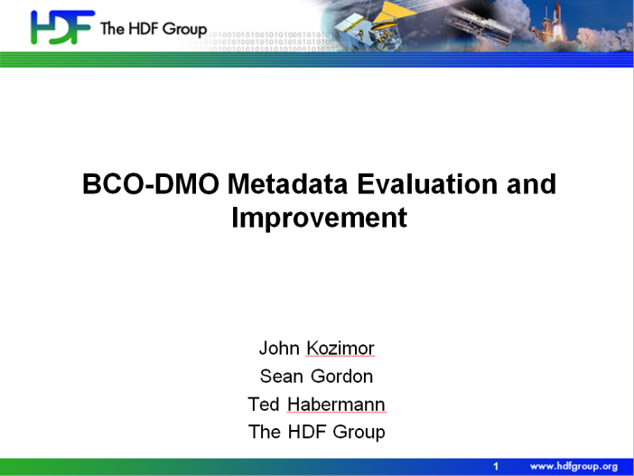
Metadata improvement

Slide 14
process
Summer ESIP 2015: initial interest
Summer ESIP 2016: review of 100 BCO-DMO ISO records; recommendations
Nov 2016: workshop in Woods Hole; review of 100 improved BCO-DMO ISO records
Dec 2016: metadata improved; reassessed

Slide 15
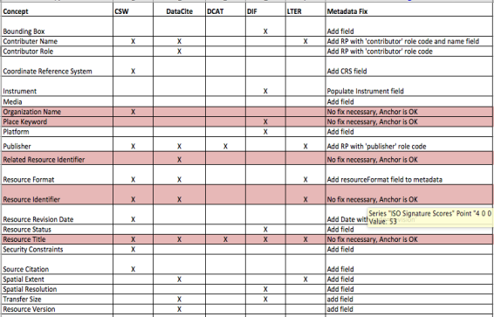
before
Collection: GEOTRACES metadata collection
Dialect: ISO 19115
Recs: CSW, DataCite, DCAT, DIF, LTER
22 concepts missing in some degree from GEOTRACES
5 concepts that use anchors (red) were falsely flagged as missing. These concepts are fine.
17 concepts missing: 7 CSW
7 DataCite
1 DCAT
6 DIF
4 LTER

Slide 16
after

Slide 17
benefits
Tools yield useful summaries (doc links and other useful features)
Improved ISO metadata records only 4 missing concepts (was 17)
Understanding of our ability to generate DataCite, DCAT and GCMD metadata
Helped to improve the process
Notes:
EXAMPLE: http://www.bco-dmo.org/dataset/3045/iso

Slide 18
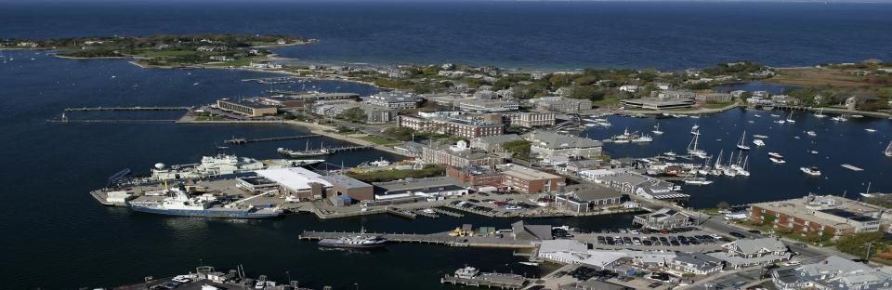
Thank you
Comments . . . Questions?
Woods Hole, Massachusetts, USA
BCO-DMO research funded by: NSF OCE-1435578 (BCO-DMO)
Notes:
Photo credit: Tom Kleindinst, WHOI

